Slide 1
Taiwan Customer Default Case Study
By:
Syed Shoaib Mohammad.

Slide 2
Business Problem Understanding:
In 2005, Taiwan was confronted with a cash card crisis. Through the year of 2005, the total default volume in Taiwan amounted to over 30 billion NT$. The number of over-borrowing people was about 300,000 to 400,000(almost 1.7% of the total population and 2% of adult population).The average loan value was more than 1.9 million NT$. The outbreak of debt crisis exerted an overwhelming influence on Taiwan’s economic development and social stability.
In this case study we would try to explore what were the traits of these over-borrowers and also come up with an internal scoring mechanism and recommendations that could have been used for controlling bad debts.

Slide 3
Data at a glance:
The data consists of 30000 observations and 24 variables and no missing values.
Default: (Yes = 1, No = 0) ; 22% Default rate in the overall data.
LIMIT_BAL: Amount of the given credit (NT dollar): it includes both the individual consumer credit and his/her family (supplementary) credit.
SEX: Gender (1 = male; 2 = female).
Education: (1 = graduate school; 2 = university; 3 = high school; 4 = others).
Marital status: (1 = married; 2 = single; 3 = others).
Age in (years).
Sep- Apr(2005): History of past repayment status. The measurement scale for the repayment status is: -1 = pay duly; 0=Late payment; 1 = payment delay for one month; . . .; 8 = payment delay for eight months.
BILL_AMT1-BILL_AMT6(2005): Amount of bill statement (NT dollar). BILL_AMT1 = amount of bill statement in September; . . .; BILL_AMT6 = amount of bill statement in April.
PAY_AMT1-PAY_AMT6(2005): Amount of previous payment (NT dollar). PAY_AMT1 = amount paid in September; . . .; PAY_AMT6= amount paid in April.

Slide 4
EDA of continuous variables:
The variable Limit Balance is skewed to the positive side with an average of 167,500 NT$ approx.,.
The billed amount for all the months have majority of the observations between -100,000 NT$ to 200,000 NT$ (we see a negative bill amount may be due to overspending against the available limit).
Box Plots show that there are outliers in the billed amounts for all months, the median seems to be even across all months and the IQR range seems narrow.
Box Plots for Payment amount has extremely narrow IQR.

Slide 5
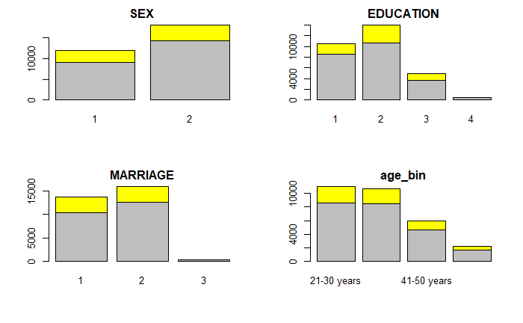
EDA of categorical variable:
University(2) and High school(3) as highest education have a higher contribution towards default with 23% and 25% respectively in the given category.
Males(1) have higher default rate of nearly 24% in the given category despite the maximum customer base count is of females.
Marital status as Married(1) and others(3) have a higher percentage of default in the given category with 23% approx., but observation for status others is less.
Default rate contribution for each age bucket is between 20-25%, highest is for age bucket 51-79 years, and average Limit Balance is highest for age bucket 31-40 years.

Slide 6
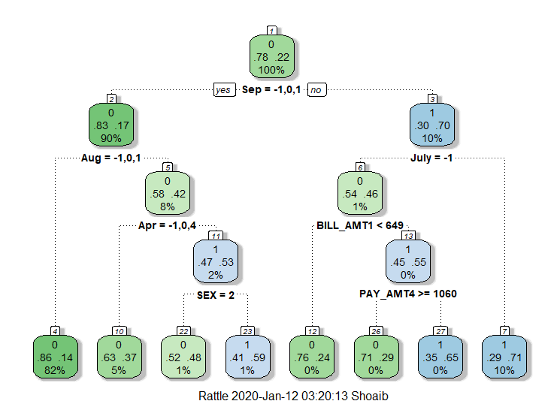
Decision Tree
A customer who has been late in making repayments in the past at least by 2 months as it stands in the month of September along with customers repayment status who have not payed duly in the month of July and those who did pay, if their billed amount is greater than 649NT September and have made a payment greater than or equal to 1060 NT$ the month of July, tend to default on their payments.
Customer who have payed duly along with those who have not been late(more than a month) as it stands in the month of September but have been late in repayments as it stands in August and April by at least 2 months especially Males, tend to default on their payments.

Slide 7
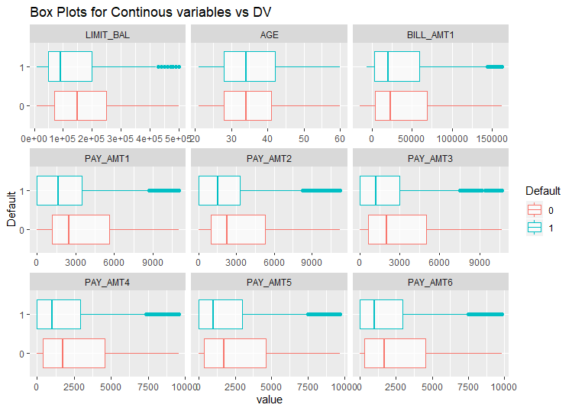
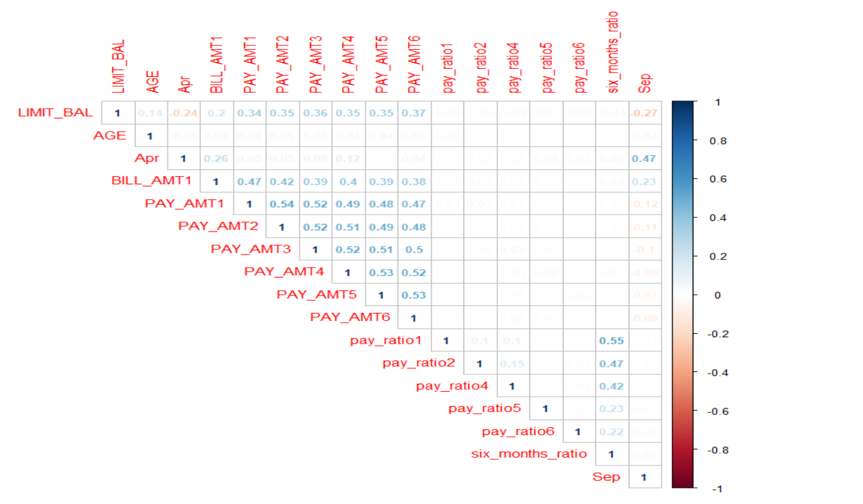
View of the attributes after data cleaning:
Outlier Treatment by capping to the min and max of the Lower quartile and Upper quartile, shows a significant difference in the IQR of Defaulters to Non-Defaulters.
Highly correlated variable have been Dropped from further analysis.
New variables in terms ratio of the payed amount to the billed amount for the respective month, along with the total ratio for six months have been created to check if we are able to gain more insights.

Slide 8
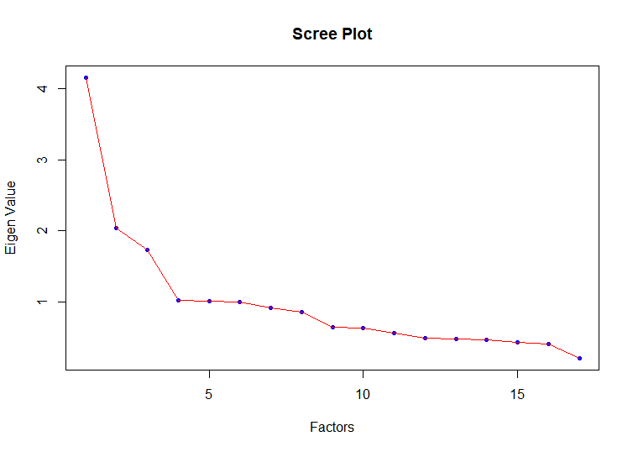
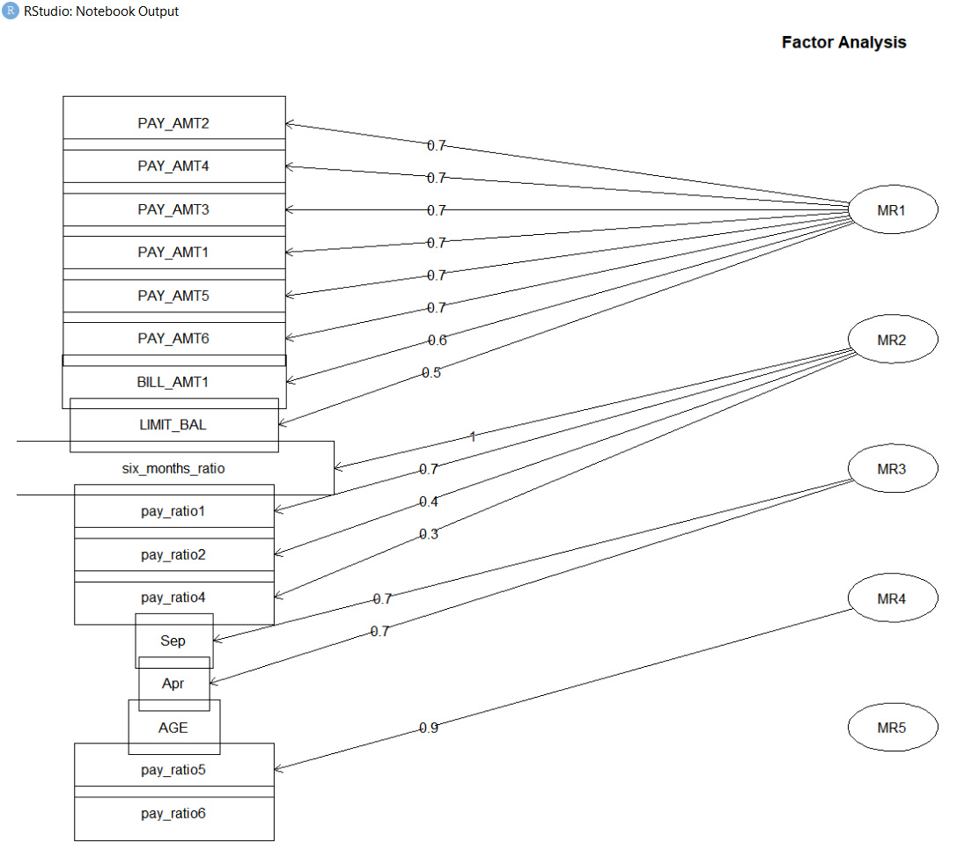
Dimensionality Reduction:
The scree plot (Kaiser rule) suggests that 5 factors will be able to explain the maximum variation among attributes, considering the factors as a linear combination of the variable.
Factor MR1 shows the correlation between attributes Credit Limit (LIMIT_BAL), Bill Amount for the month of September (BILL_AMT1), Amount payed towards the credit since April to September (PAY_AMT6-PAY_AMT1). Factor MRI can be named as behaviour/usage/score of the credit available and its usage including the repayments made towards it. We shall keep the remaining attributes as they are and bind the scores of MR1 to the prepared data for further analysis. The final dataset consists of 30000 observations and 17 variables.

Slide 9
Model Building:
A simple logistic regression model was built to understand the significance of the variables contributing towards “Default” and to check for VIF, only those variables that turned out to be significant were used to build the models.
The Data has been split into train and test with the ratio of 70:30, All the models have been built using 10 fold cross validation to reduce the chances of model overfitting. The probabilities from the training model have been fit onto the test data and have computed an optimum threshold to most importantly reduce False Negatives by computing ROC, the parameters used here to judge the best performing models are, AUC, Confusion Matrix and Gini co-efficient.
Towards the end, the outcomes of each and every model with the predicted outcomes of o’s and 1’s were attached to the actual default variable and a logistic regression was built on this with “Default” as the target variable, to choose the best model as well.

Slide 10
Model Comparisons:
Model | Confusion Matrix & ROC | AUC | Gini-Coefficient | Insights
Logistic Regression | Accuracy:78% Sensitivity:51% Threshold:20% | 72% | 44% | -The History of repayments, showing how many months a customer has been late in their payments in the past as it stands on September, followed by the Credit. Score (a credit usage Indicator) are Important variables that would predict defaults. -Increase in Age has a positive impact on Default of the customer assuming remaining variables are constant. -A unit increase in the number of months a customer has been late in repayments as it stands on April has a positive impact on default assuming remaining variables are constant. -Males have a positive impact in towards default as compared to females. -Education categorized as “others” has a negative impact as compared to that of graduate Assuming remaining variables are constant. -Customer who are single have a negative impact on default as compare to that of married customers assuming remaining variables are constant.

Slide 11
Model | Confusion Matrix & ROC | AUC | Gini-Coefficient | Insights
K-Nearest Neighbour | Accuracy:77% Sensitivity:51% Threshold:30% | 73% | 47% | - The History of repayments, showing how many months a customer has been late in their payments in the past as it stands on September, followed by the Credit. Score (a credit usage Indicator) are Important variables that would predict defaults.
Random Forest | Accuracy:76% Sensitivity:52% Threshold:10% | 73% | 47% | - The History of repayments, showing how many months a customer has been late in their payments in the past as it stands on September, followed by the Credit. Score (a credit usage Indicator) are Important variables that would predict defaults.
Bagging | Accuracy:72% Sensitivity:53% Threshold:30% | 70% | 41% | - The History of repayments, showing how many months a customer has been late in their payments in the past as it stands on September, followed by the Credit. Score (a credit usage Indicator) are Important variables that would predict defaults.

Slide 12
Model | Confusion Matrix & ROC | AUC | Gini-Coefficient | Insights
Boosting | Accuracy:70% Sensitivity:65% Threshold:20% | 75% | 50% | - The History of repayments, showing how many months a customer has been late in their payments in the past as it stands on September is an Important variable that would predict defaults.
Neural net | Accuracy:70% Sensitivity:66% Threshold:20% | 75% | 50% | - The History of repayments, showing how many months a customer has been late in their payments in the past as it stands on September, followed by Education category as “others” are Important variables that predict defaults.

Slide 13
Business Insights:
The best performing model is Logistic Regression, The models suggest that following;
Customers credit usage patter including payments made towards the credit in Q2 & Q3 which has been combined to create a score/Behavioural score/Internal Score, for each of the customers is an important variable that helps predict default.
The History of repayment status as it stands at the beginning of the Q2 and the end of Q3 helps determine if a customer would default on their payments.
Customer being a male has a positive impact towards default.
Customer Education classified as “others” has a negative impact towards default.
Age of a customer as well has a positive impact towards default.
Customer marital status as single has a negative impact towards default.

Slide 14
Recommendations:
Customer should not be allowed to spend over and above their available limit balance.
Customer who payed duly for the month of July and if their payment amount for that month was greater than 1060 NT$ and despite that if that billed amount for September is greater than 649 NT$ and if these customers have been late in their payments in the past at least by 2 months should be considered as high Risk and can be targeted to reduce the credit available and increase in penalties for payment delays(if late by a month or more).
Male customers who have been late by at least 2 months in their repayments as it stands in April and August , but have not been late by more than a month in the repayment in September can be categorized as medium risk and can be targeted to increase penalties for payment delays(if late by a month or more).
Customers who are single or education as “others” can be provided with rewards point scheme or an increase in the credit available.
Customers aged above 51 years can be categorized as high risk.

Slide 15


